Slide 1

DDD anche nei Dati?
(AKA Data Mesh)

Slide 2

All we need is Data!
All we need is Data!

Slide 3
NewVantage Report
NewVantage Report
Have a data culture
27 %
Become data-driven
38 %
Competing on data
45 %
Investments > $50
65 %

Slide 4
Failure Symptoms
Failure Symptoms
Fail to bootstrap
Fail to scale sources
Fail to scale consumers
Fail to materialize Data-Driven value

Slide 5

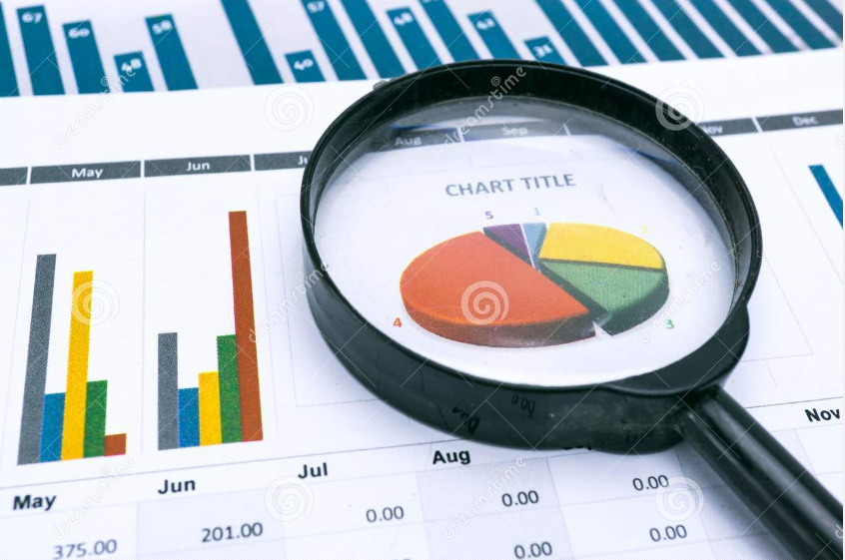
Operational vs Analytical
Operational
Analytical
E
T
L

Slide 6
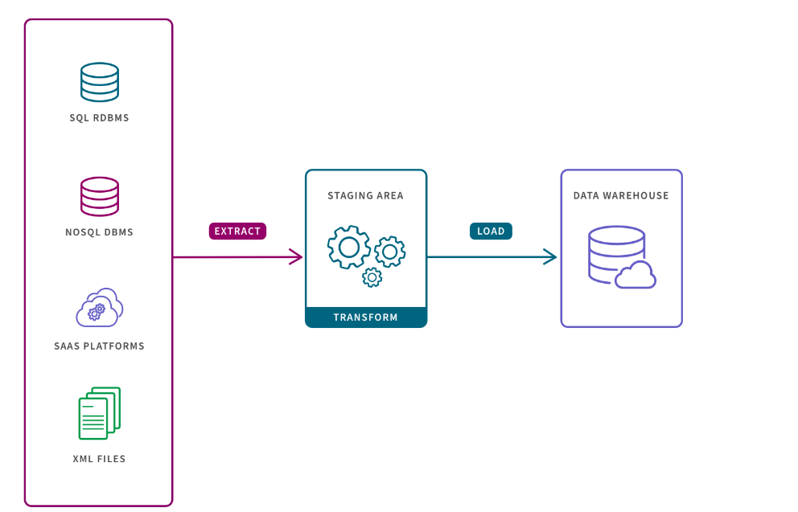
Misintegration
Misintegration

Slide 7
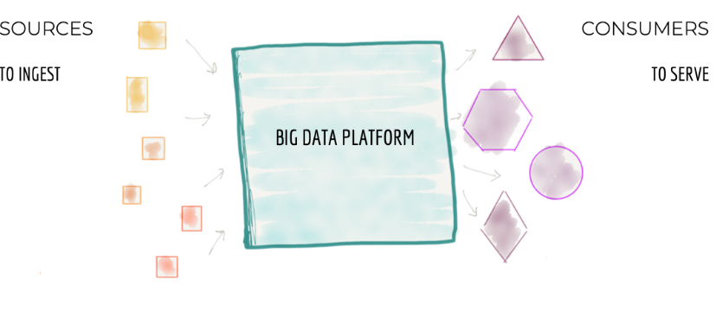
Failure Symptoms
Centralized
Monolithic

Slide 8
Failure Symptoms
Decomposition
INGEST
FEATURES
AGGREGATE
CAPABILITIES
SERVE
Scale Architecture with top-level technical partitioning
Architecture decomposition orthogonal to change

Slide 9
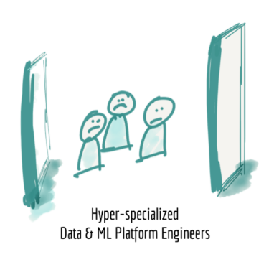
Misintegration
Hyper-specialized silos

Slide 10
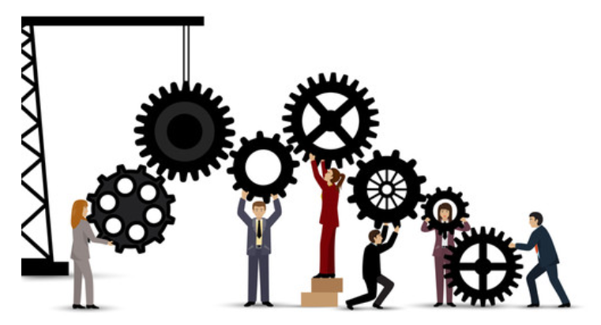
Failure Symptoms
Disconnected

Slide 11
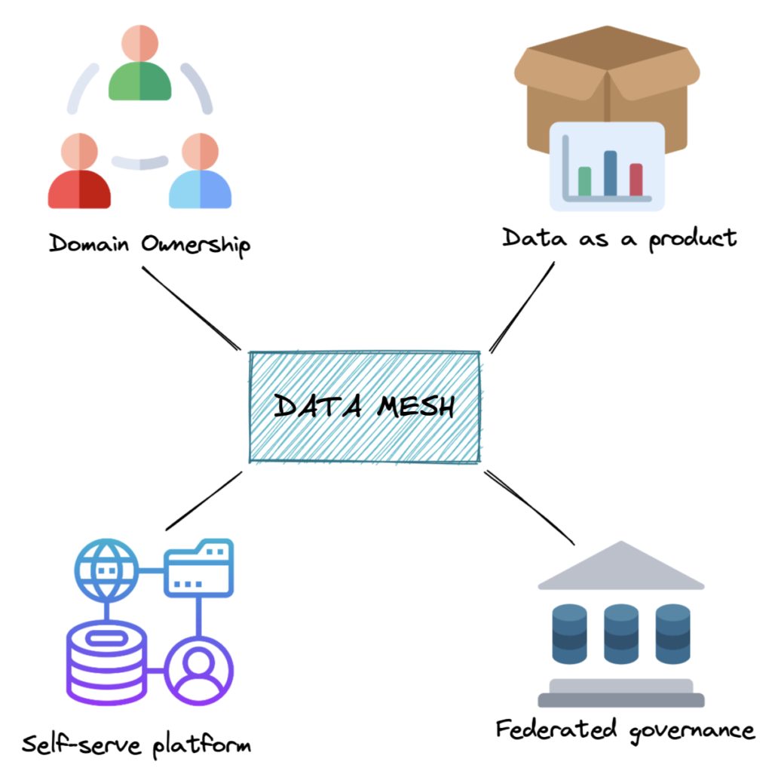
Data Mesh (Zhamak Dehghani)
Data Mesh
(Zhamak Dehghani)

Slide 12
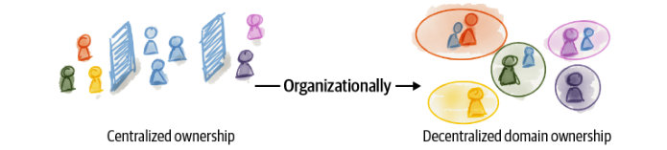
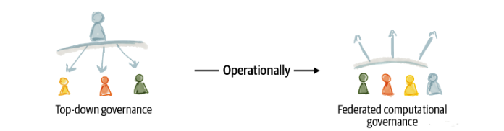
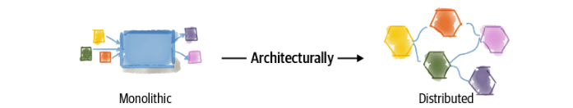

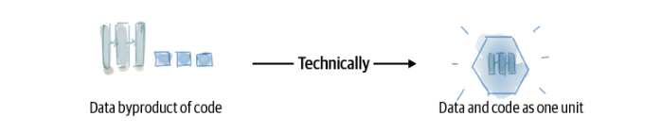
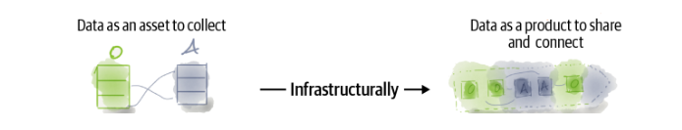
A socio-technical approach

Slide 13

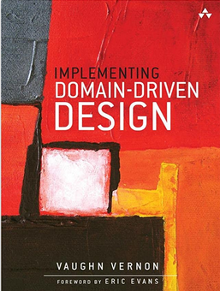
Domain-Driven Design

Slide 14
DDD’s approach
Pattern Strategici
Pattern Tattici
Ubiquitous Language
Entity
Bounded Context
Value Object
Context Mapping
Aggregate
Aggregate Root

Slide 15
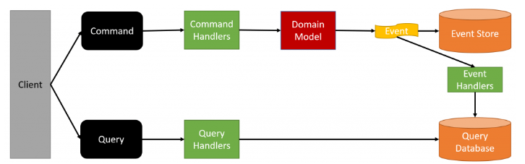


CQRS + ES
CQRS/ES
(Greg Young)
CQRS and Event Sourcing Introduction – Greg Young
The CQRS and Event Sourcing Long Position

Slide 16
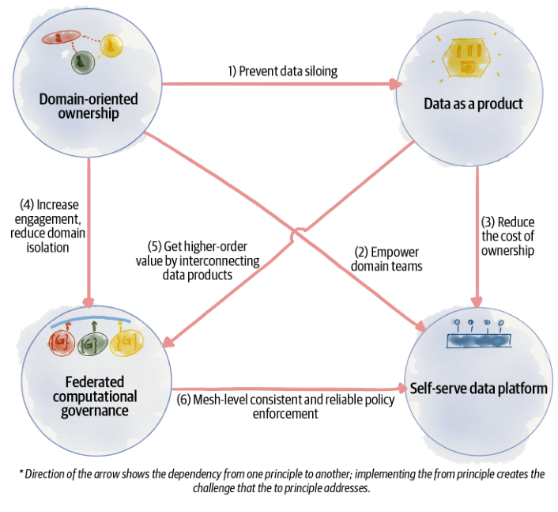
The Principles
The
Principles

Slide 17
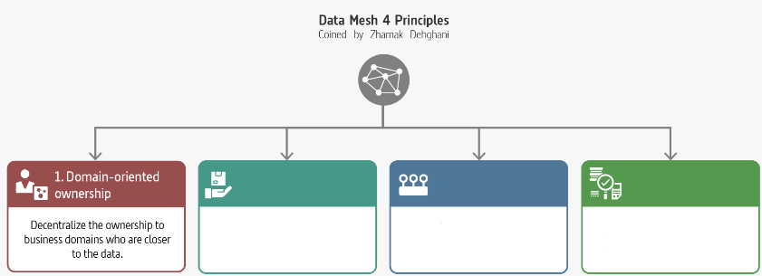
Domain-Oriented Ownership

Slide 18
Decompose Data Around Domains
Domains aligned with the origin of data
Domains aligned with the consumption
Domains aligned with shared aggregates
Distributed the ownership

Slide 19
Motivations
The ability to scale data sharing aligned with the axes of organisation growth
Optimize continuous change by localize change in business domains
Support agility by reducing the need for synchronize between teams
Increase the resilience of ML solutions by removing complex intermediate data collection pipelines

Slide 20
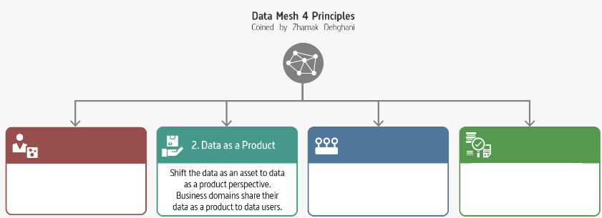
Data as a Product

Slide 21
A Succesful Product
A Succesful Product
Usable
Discoverability
Trusthful (trustworthy)
Interoperable
Valuable
Understanding
Natively Accessible
Feasible
Marty Cagan «Inspired»
Don Norman «The design of every day things»
«A confident relationship with the unknown» Rachel Botsman

Slide 22

Failure Symptoms
Data
Product
Owner

Slide 23
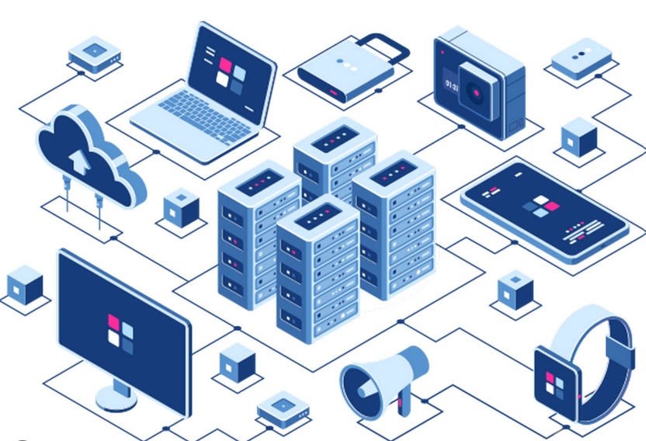
Data
as a
Product
Code
Data Product
Polyglot Data
Infrastructure

Slide 24
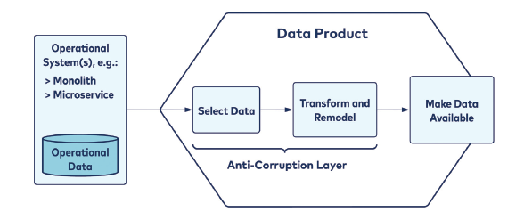
Data Mesh (Zhamak Dehghani)
Domain Boundary

Slide 25
Misintegration
Building a Data Product
Facts are read-only
Only the data product owner can add new facts to the data product.
Facts are immutable
Data product owners can append new facts as an addendum to previous facts, but cannot modify, overwrite, or delete them
Facts are timestamped
Each fact contains a timestamp representing when it occurred, such that time-based ordering is made possible

Slide 26
Misintegration
Transformation to a Data as a Product
Data as an asset
Data as a product
Byproduct
Product
Data as an output of compute
Data and compute as one unit

Slide 27
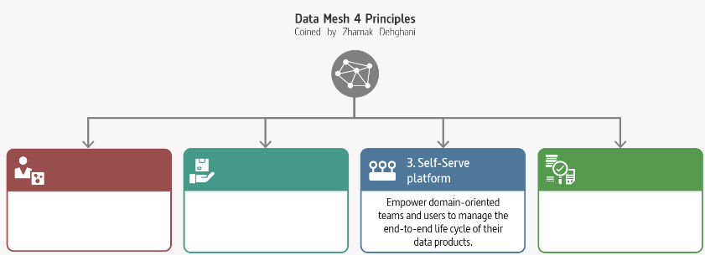
Self-serve Data Platform

Slide 28
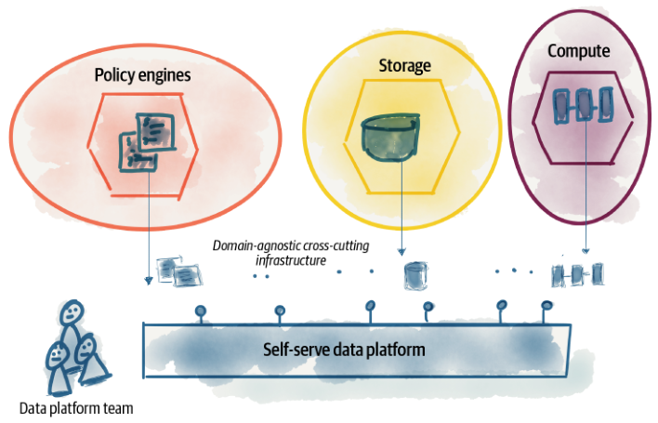
Failure Symptoms
Team
Autonomy

Slide 29
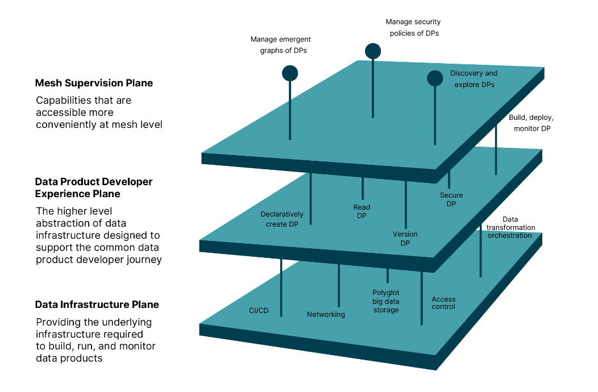
Logical Architecture
Logical
Architecture

Slide 30
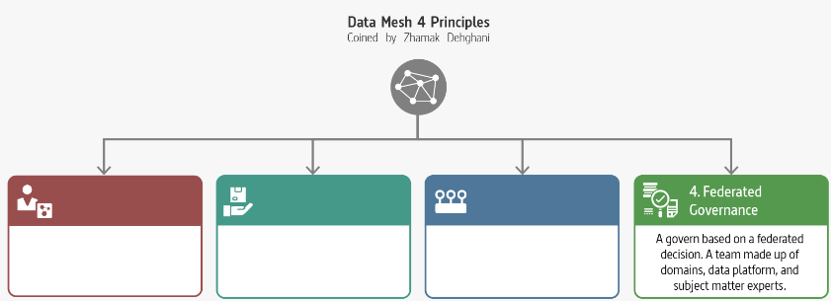
Misintegration
Federated Computional Governances

Slide 31
Federated Computional Governances
Decentralization and domain self-sovereignty
Interoperability through global standardization across data products
A dynamic topology
Automatic exection of decisions and policies by the platform
Maintains equilibrium between centralization and decentralization

Slide 32
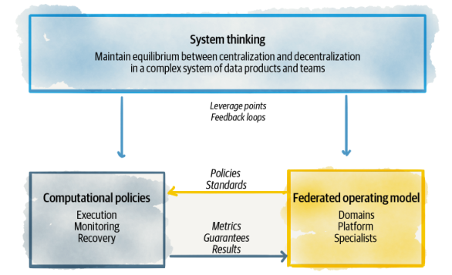
Failure Symptoms
Equilibrium

Slide 33
Transformation to Federated Computational Governance
Centralized team of data experts
Federated team of domain owners and subject matter experts
Responsible for data quality
Responsible for defining what constitues quality
Responsible for data security
Responsible to define aspects of security
Responsible for canonical data modeling
Responsible for modeling polysemes
Measure success based on volume of data
Measure success based on value generated through network effect of the mesh-consumption of data

Slide 34
Data Fabric
Is an architecture pattern
Integrates and connects all your organization’s data
Accelerates self-service data discovery
Delivery real-time analytics and insights by optimizing the data lifecycle
Active Metadata
Strong Data Integration / Preparation / Orchestration

Slide 35
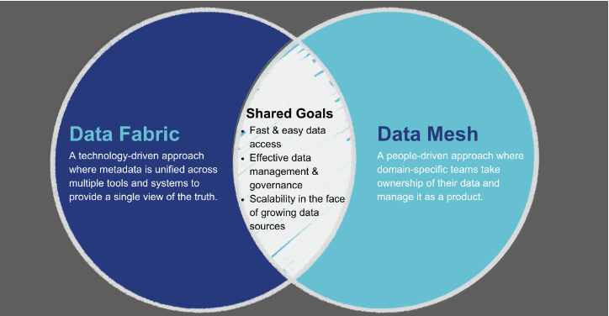
Failure Symptoms
Data Fabric
e
Data Mesh

Slide 36
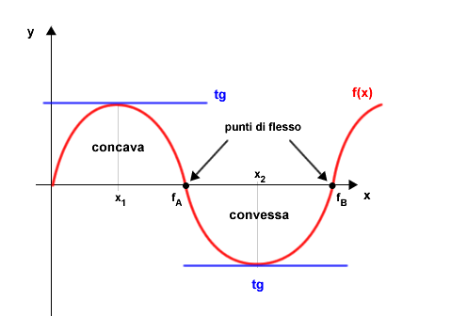
Failure Symptoms
To Data Mesh
or not to
Data Mesh?

Slide 37

Misintegration
A New Order
You hear that Mr. Anderson? That is the sound of inevitability …

Slide 38
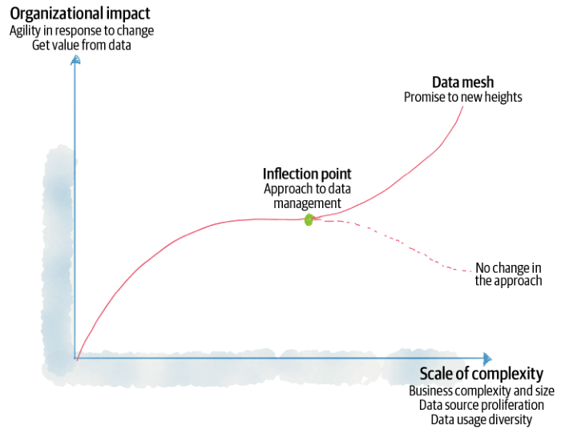
Failure Symptoms
Data Mesh
Inflection Point

Slide 39
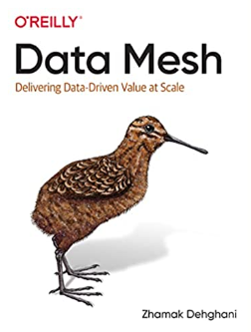





Misintegration
References
Zhamak Dehghani
Introduction to Data Mesh
Martin Fowler
Data Mesh Principles and Logical Architecture
Practical Data Mesh

Slide 40








About me
alberto.acerbis@intre.it
https://github.com/brewup
https://github.com/cqrs-muflone
https://github.com/ace68
https://www.twitch.tv/dddbrewup

